Slide 1
Python Exception Handling
DVT101 – Lecture 42
- By Dataverse Tutorials

Slide 2
What is Exception Handling in Python?
Meaning of exceptions in programming
Unexpected runtime problems
Program crash vs graceful handling
Why exception handling is necessary

Slide 3
Why Programs Fail Without Exception Handling
Abrupt program termination
Poor user experience
Data loss risks
Debugging difficulties

Slide 4
Real-World Analogy of Exception Handling
Road accidents and safety systems
ATM transaction failures
Online form validation
Controlled recovery instead of crash

Slide 5
Errors vs Exceptions
Definition of errors
Definition of exceptions
Compile-time vs runtime issues
Which can be handled and which cannot

Slide 6
Common Types of Errors
Syntax-related problems
Logical program errors
Memory and system-level issues
Why errors stop execution

Slide 7
Common Types of Exceptions
Runtime input-related issues
Mathematical calculation problems
File and resource access issues
User-driven mistakes

Slide 8
Python Exception Handling Keywords
try block purpose
except block purpose
else block role
finally block role

Slide 9
How try–except Works Internally
Risky code execution
Exception detection flow
Matching exception types
Safe recovery mechanism

Slide 10
else and finally Blocks
When else executes
Why finally always runs
Cleanup and resource release
Professional coding practice

Slide 11
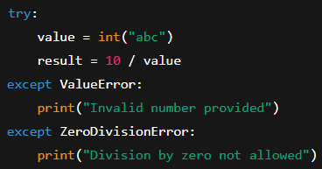
Catching Specific Exceptions
Handling different errors differently
Avoiding generic error masking
Better debugging clarity
Predictable error responses

Slide 12
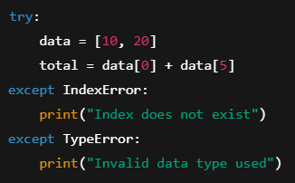
Program Concept: Multiple Except Blocks
Handling multiple exception types
Grouping similar exceptions
Cleaner error-handling logic
Real-world validation cases

Slide 13
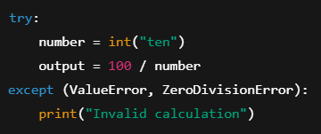
Catching Multiple Exceptions Together
Tuple-based exception handling
Reducing repetitive code
When same response is needed
Balanced flexibility

Slide 14
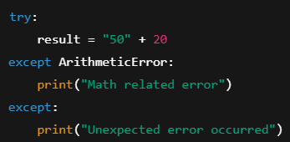
Catch-All Exception Handlers
Using generic except block
Risks of hiding real issues
When catch-all is acceptable
Best practices

Slide 15
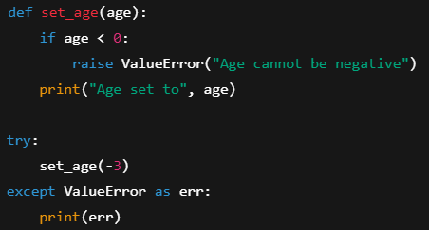
Raising Exceptions Manually
Why raise exceptions
Enforcing valid program state
Business rule validation
Controlled failure design

Slide 16
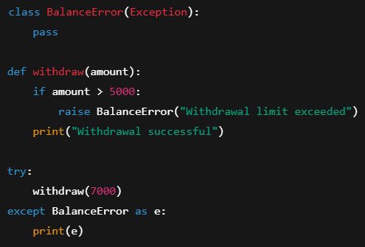
Custom Exceptions
Need for application-specific errors
Inheriting from Exception class
Meaningful error messages
Large system usage

Slide 17
Advantages & Disadvantages
Improved reliability
Cleaner separation of logic
Performance overhead
Complexity trade-offs

Slide 18
Summary & Key Takeaways
Exception handling mindset
Safe and stable programs
Debug-friendly design
Industry-ready coding habit

Slide 19


